Slide 1
Did you have your java today?

Slide 2
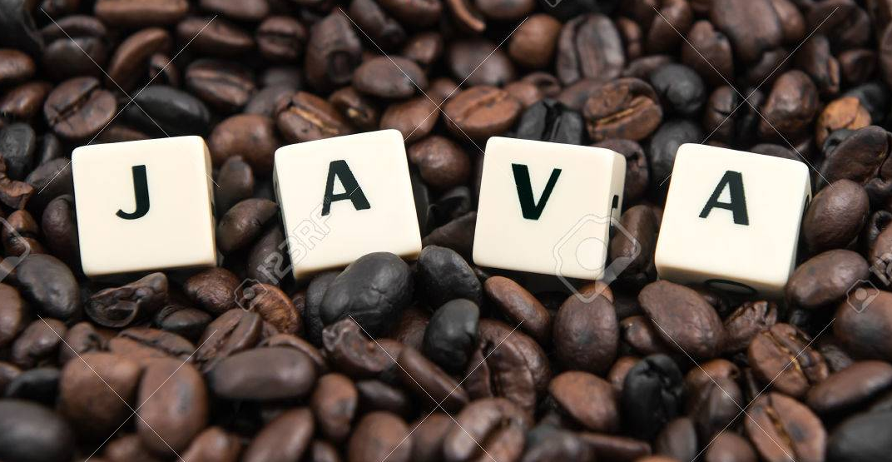
Java actually means coffee

Slide 3
Origin of java
Java was designed by James Gosling and colleagues at Sun Microsystem in early 1995.
Java was started as a project called Oak by James Gosling in 1991.

